Slide 1
Chapter 9
Heap
Objectives
Define and implement heap structures
Understand the operation and use of the heap ADT

Slide 2
9-1 Basic Concepts
A heap is a binary tree whose left and right subtrees have values less than their parents. The root of a heap is guaranteed to hold the largest node in the tree.
Both the left and the right branches of the tree have the same properties.
Heaps are often implemented in an array rather than a linked list. When arrays are used, we are able to calculate the location of the left and the right subtrees. Conversely, we can calculate the address of it’s parent.
The tree is complete or nearly complete. The key value of each node is greater than or equal to the key value in each of its descendents. This structure is also called max- heap.

Slide 3
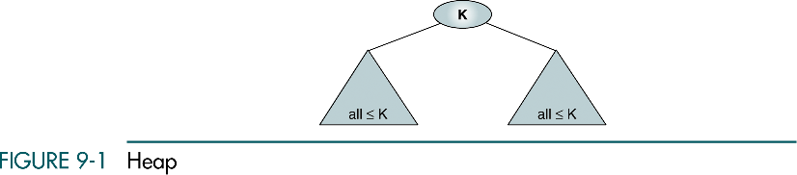
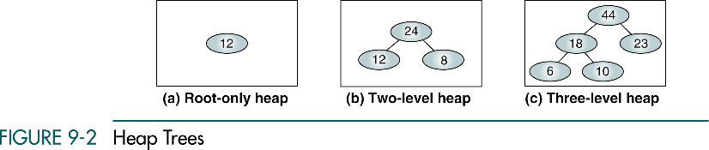

Slide 4
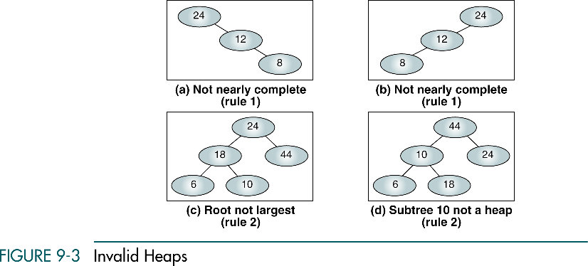

Slide 5
Maintenance Operations
Two basic maintenance operations are performed on a heap.
Insert a heap
Delete a heap
Two basic algorithms are – Reheap Up and Reheap Down

Slide 6
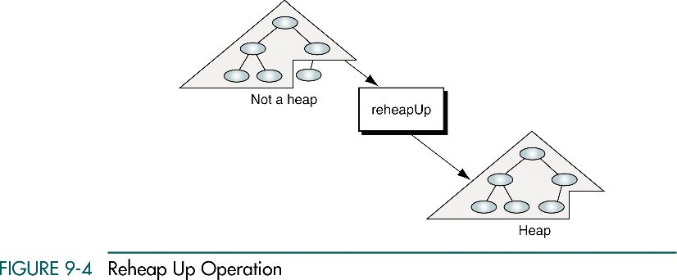
The reheap up operation repairs the structure so that it is a heap by floating the last element up the tree until that element is in its correct location.
Insertion takes place at a leaf at the first empty position. This may create a situation where the new node’s key is larger than that of its parent. If it is, the node is floated up the tree by exchanging the child and parent keys and data.

Slide 7
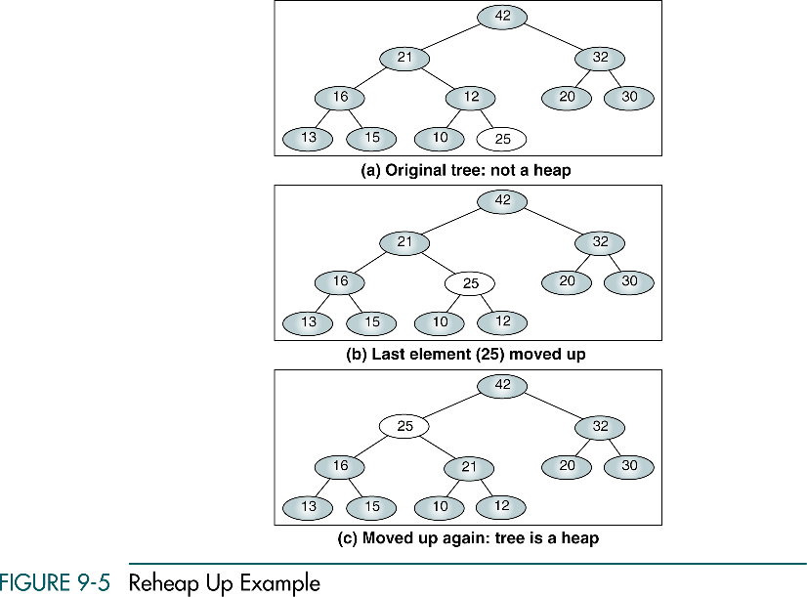

Slide 8
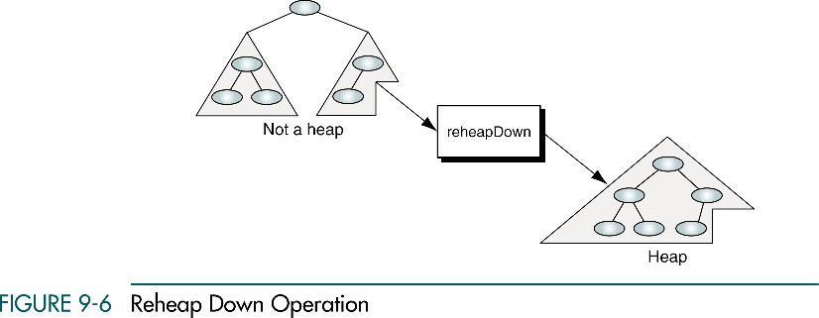
When we have a nearly complete binary tree that satisfies heap order property except in the root position. Reheap down operation reorders a broken heap by pushing the root down the tree until it is in correct position at the heap.

Slide 9
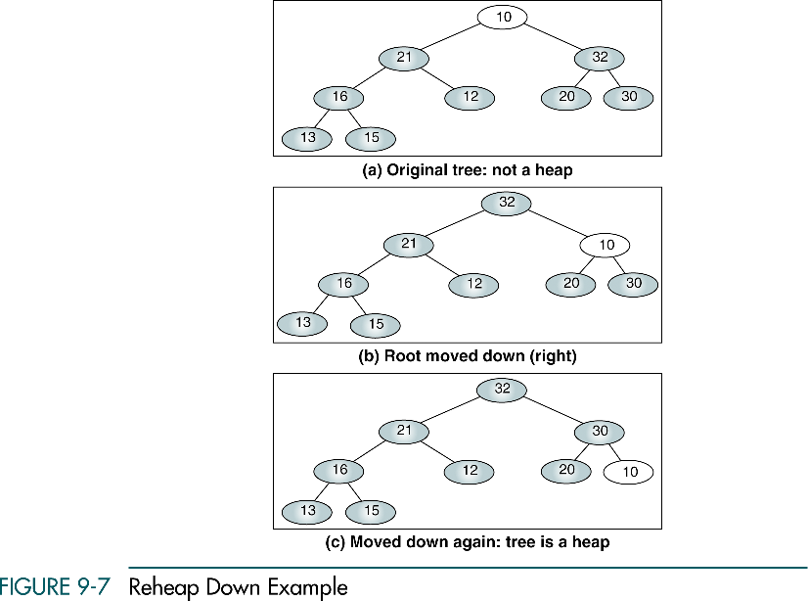

Slide 10
9-2 Heap Implementation
Heaps are usually implemented in an array structure. In this section we discuss and develop five heap algorithms.
Reheap Up
Reheap Down
Build a Heap
Insert a Node into a Heap
Delete a Node from a Heap

Slide 11
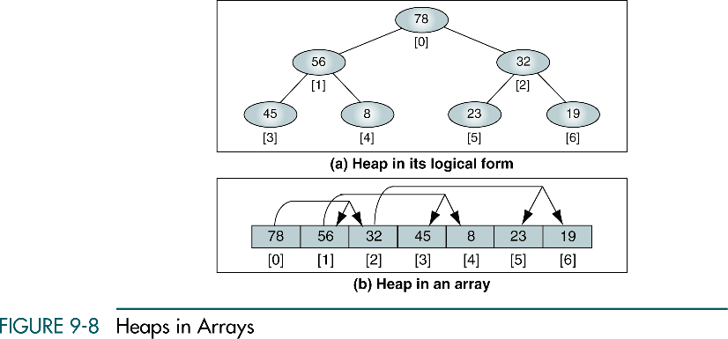

Slide 12
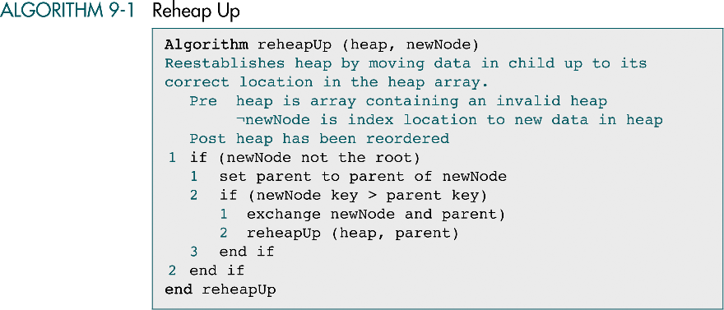

Slide 13
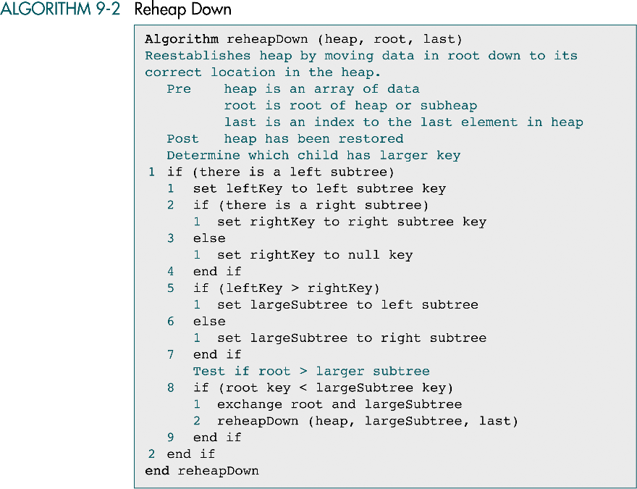

Slide 14
(continued)

Slide 15
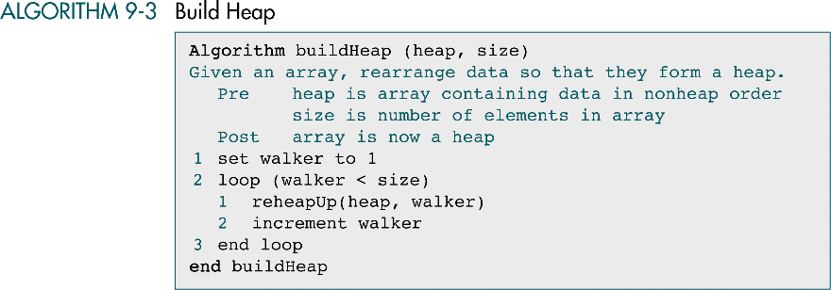

Slide 16
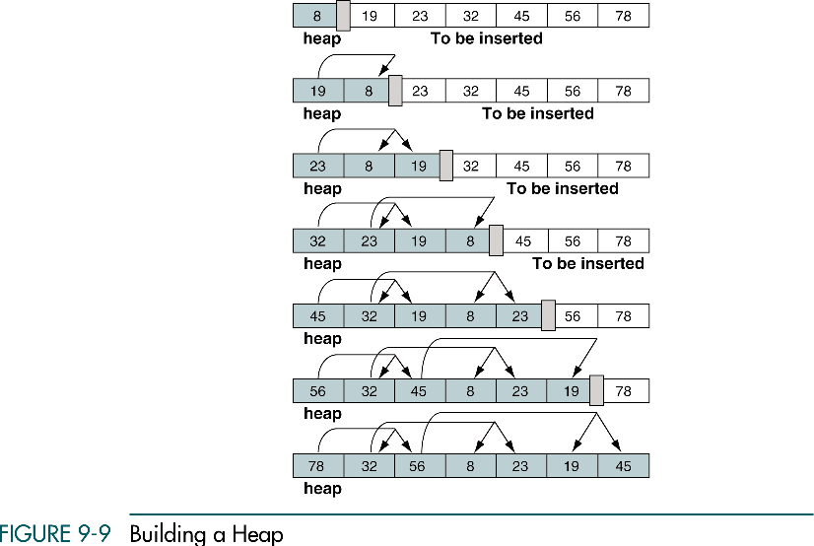

Slide 17
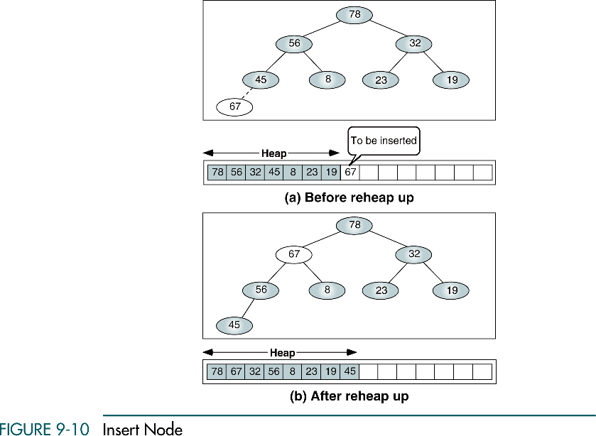

Slide 18
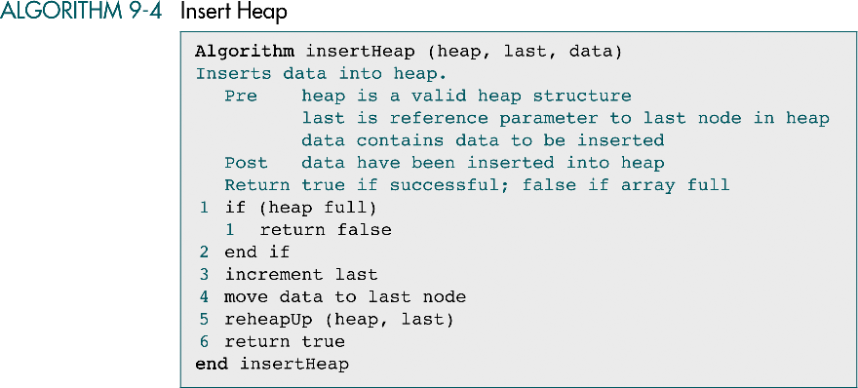

Slide 19
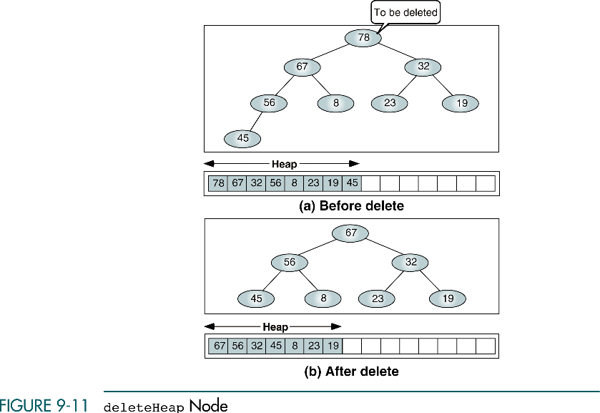

Slide 20
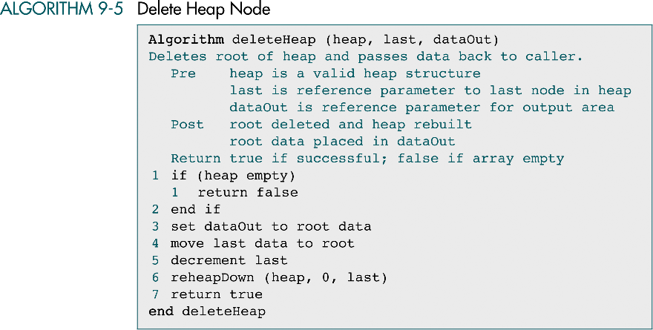

Slide 21
9-3 Heap ADT
We begin with a discussion of the heap ADT design and then develop the C code for the five major functions developed in Section 9.2.
Heap Structure
Heap Algorithms

Slide 22
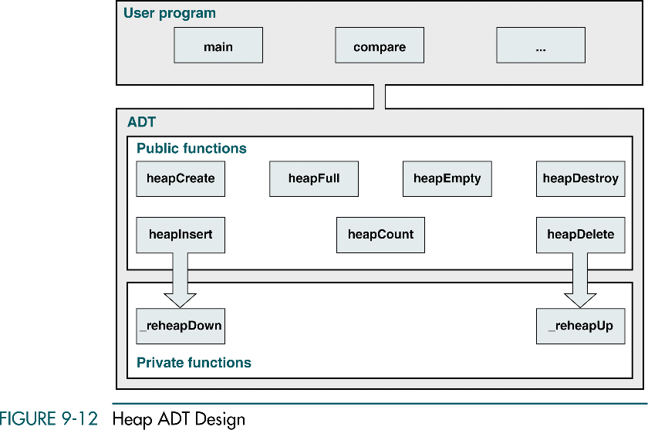

Slide 23
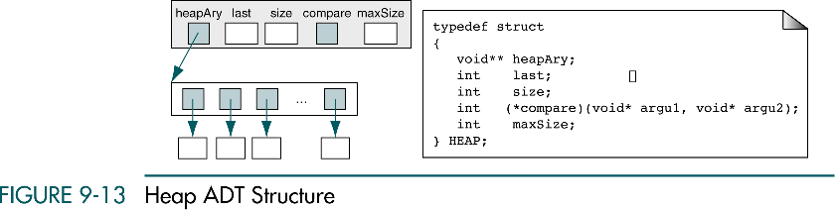

Slide 24
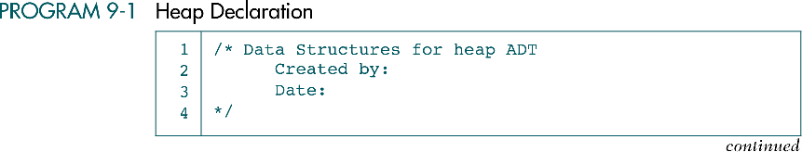
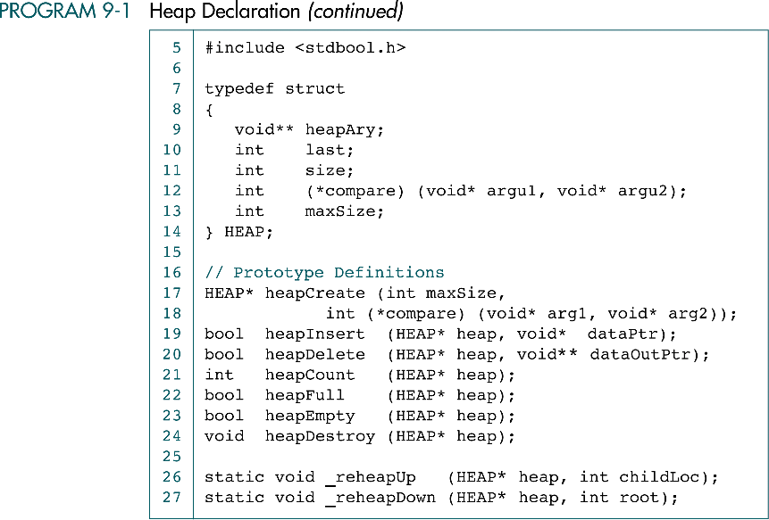

Slide 25
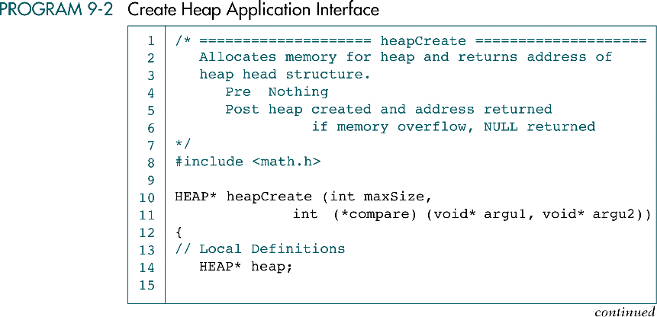

Slide 26
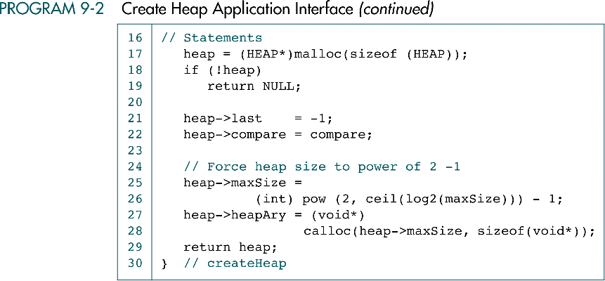

Slide 27
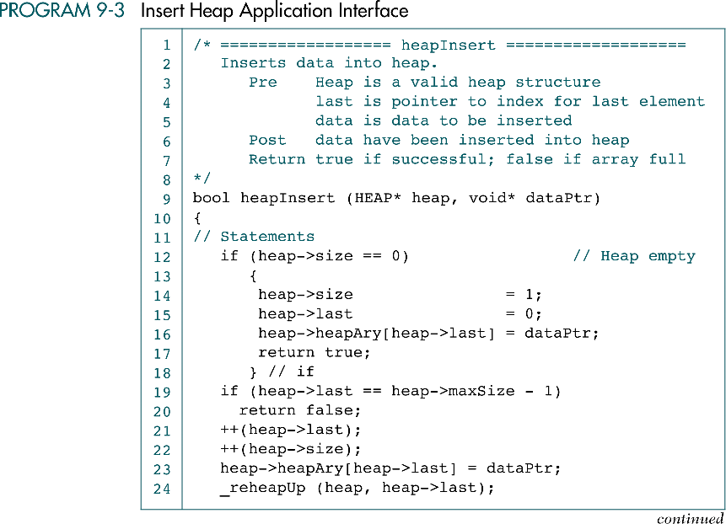


Slide 28
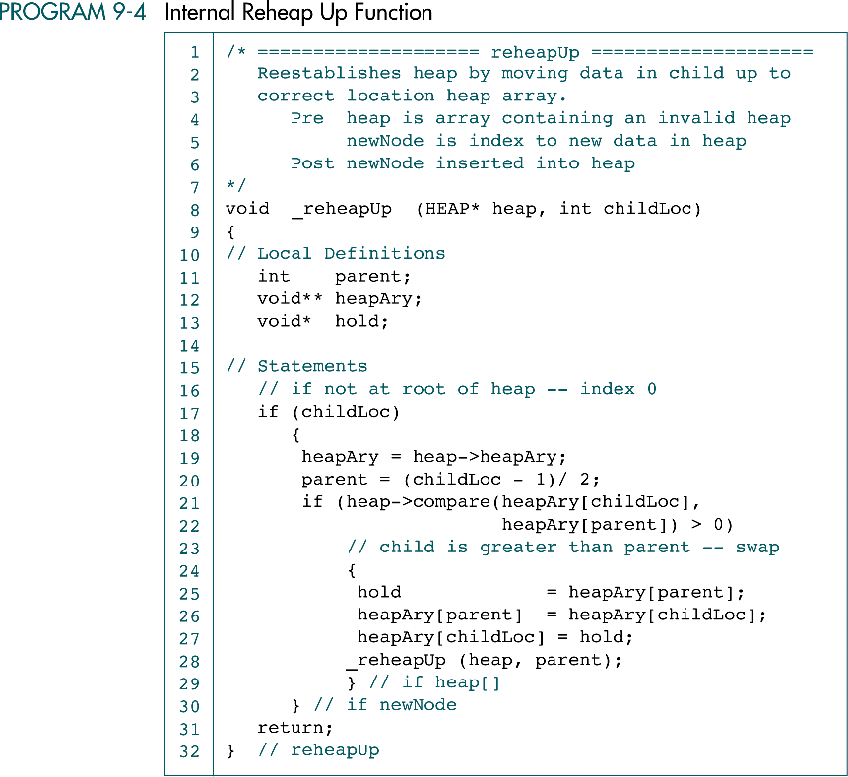

Slide 29
(continued)

Slide 30
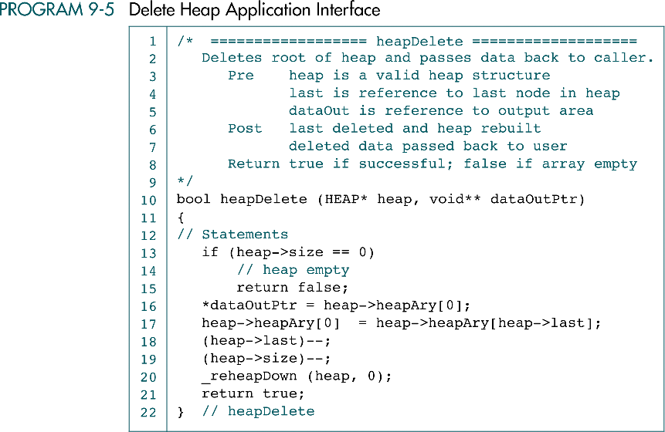

Slide 31
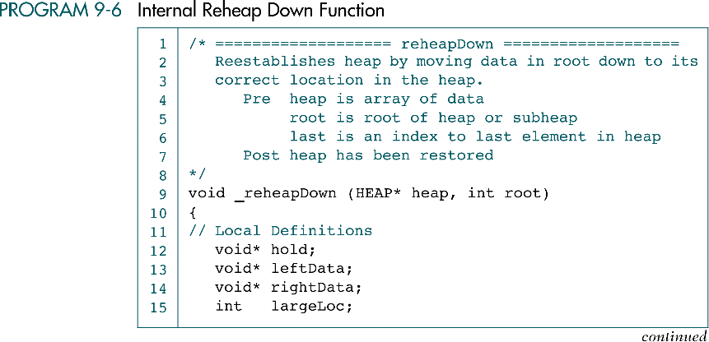

Slide 32
